Slide 1
Group 3 12-12-2018 DVA313
Erika Weilander
Christoffer Parkkila
Filip Andersson
Matko Butkovic
Osamah Al-Braichi
Mohammed Abusamaan
Sai Vijay Vemasani
Zaid Abed Jaser

Slide 2
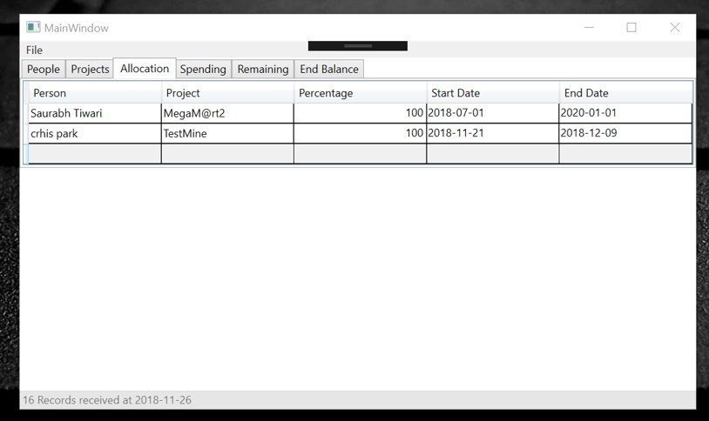
Client & application
Our client Daniel Sundmark, is responsible for the management of several concurrent projects at Mälardalen University
Daniel has been involved in the development of a desktop application
Existing application

Slide 3
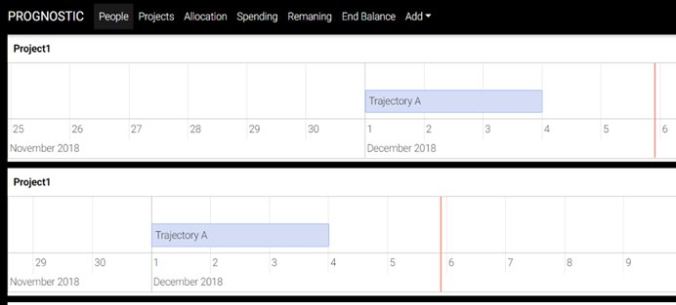
Goal
Goal is to refactor and enhance the existing application to more user-friendly
Web application provides functionalities:
managing projects,
allocation of university employees
control of spending
Set an individual duration of time on a project but also set how much percentage of their time one person is allowed to spend on the project

Slide 4
Previous presentation & Design decisions
Previous presentation:
* Implemented the main parts of frontend and backend.
* Two Groups, Three members of Backend group moved to Frontend group.
Design decisions:
* Use React instead for only HTML & CSS or php files. Help to divide the work.
* Tabs information: present data as json array.
* JSON: Use it with React & reduce using of the database.
* Bootstrap: making styling better.

Slide 5
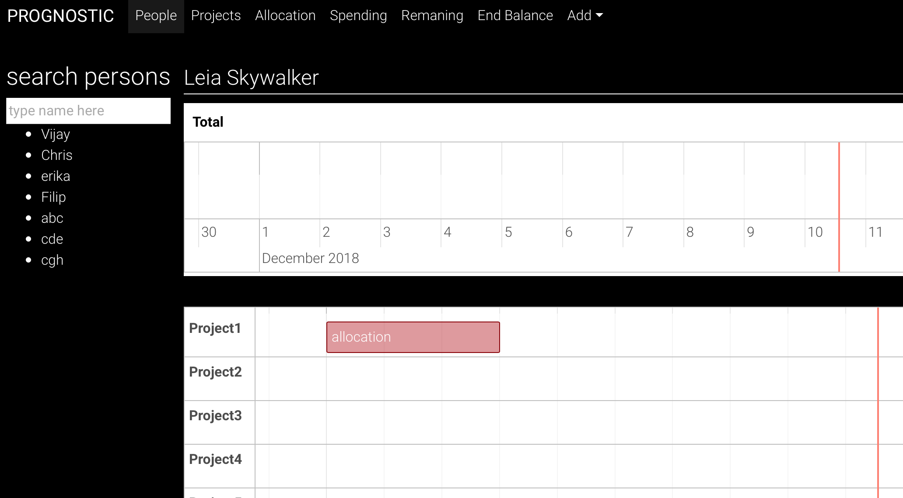
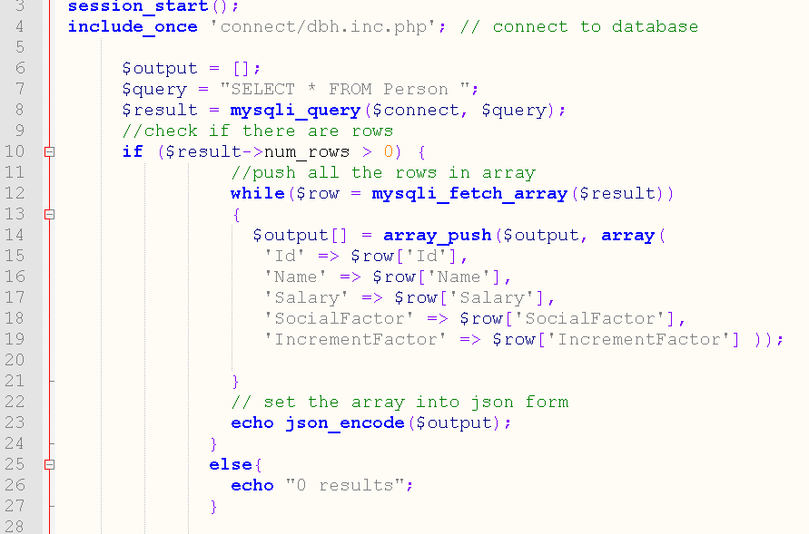
Features we implemented so far?
The project focus on interface design
Backend: Retrieve data from database as Json array.
Frontend: Navbar, Project timeline and Search function with React.
Show data on tabs is in progress. Other functions: add/delete/save etc. options.

Slide 6
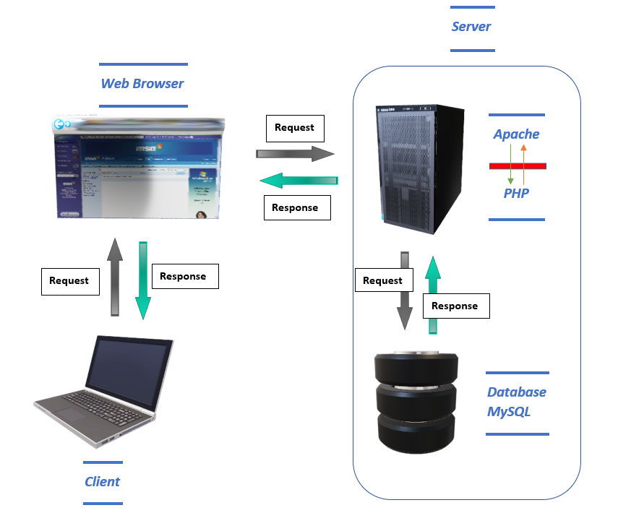
The overall high-level design of system
Main parts:
- graphical user interface
- database (MySQL)
- PHP Server
- Client
External systems: the system does not transmit information to any other system in the external environment.

Slide 7


3rd party frameworks
React: React is a JavaScript library for building user interfaces.
Hold (JavaScript and HTML)
Split webpage into components, so everyone can work individually on reusable components
Declarative: easy to generate interactive UIs, it handles the state of the components
A single page application (SPA), is a web application that behaves and looks as a desktop application. When the page has been initially loaded from the server, it never refreshes. In the SPA implementation, new content is fetched in the background through AJAX calls and then JavaScript is dynamically recreating the HTML-DOM structure to represent the new content.
Bootstrap: A framework for making responsive design (Front-end). We used it for styling the web pages to make the design friendly and interactive.

Slide 8
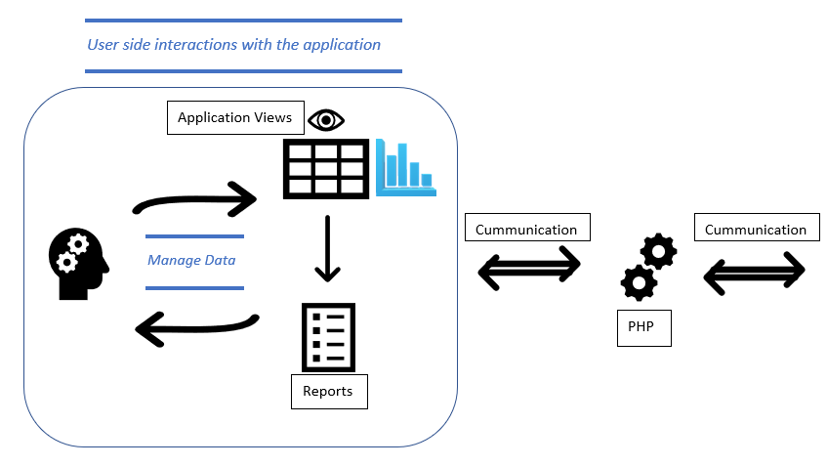

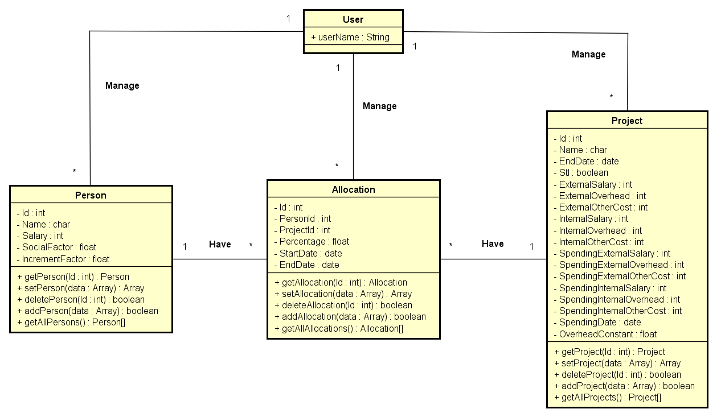
Data Flow diagram

Slide 9
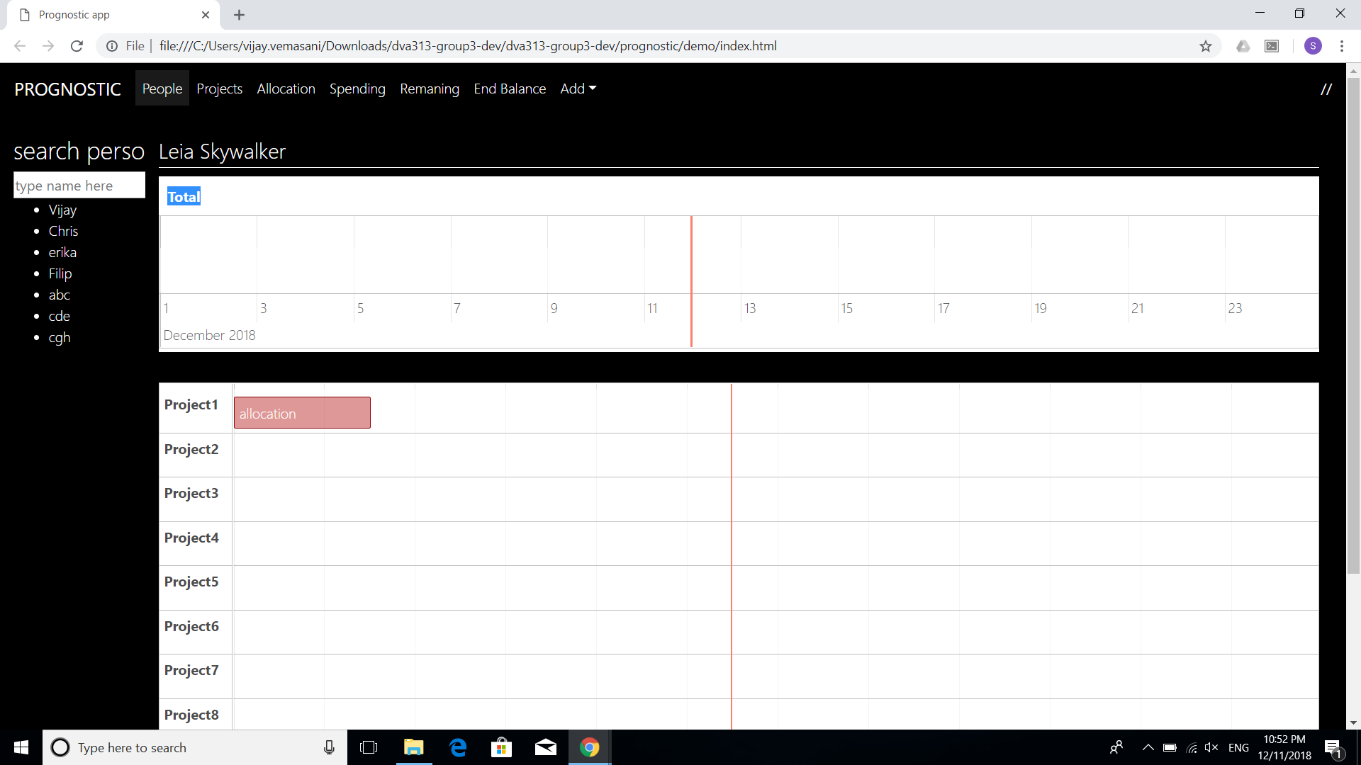
GUI Structure

Slide 10
Client Feedback
Client was satisfied with our first mock up.
Suggestions on how that data should be sent back to server.
Changes in the requirements of allocation bar.
Encouraged us to implement extra features which might be useful to the client(Low Priority)

Slide 11
Implementation phase plan
Back End:
Update the data base when changes are made by the client.
Front End:
Look and feel of the application.
Integrating the individual components of the application.
Connecting the Front-End components with Back End.

